Slide 1


An Intro to Boosted Trees
Dave King PhD
Robust Design
&
Bill Messina, PhD
Supplier Quality Assurance
September 21, 2009
Copyright © 2008 Raytheon Company. All rights reserved.
Customer Success Is Our Mission is a registered trademark of Raytheon Company.

Slide 2
What is Boosting?
The General Concept of Boosting

Slide 3
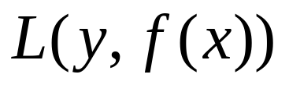
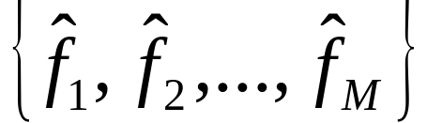
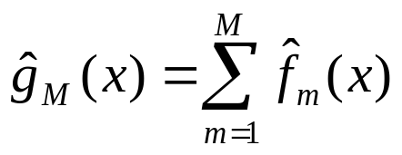




What is Boosting?
Boosting is an iterative scheme of constructing a functional model f(x), which fits a particular set of data well in the sense of minimizing any loss function
which is based upon a procedure called Forward Stagewise Additive Modeling.
In forward stagewise additive modeling we approximate the solution to (1) by making a sequence of guesses
(1)
each of which is added to the previous series of guesses
so that the final model approximation is
At each iteration m, one solves for the optimal basis function
and corresponding coefficient
to add to the current expansion
producing the new approximation

Slide 4
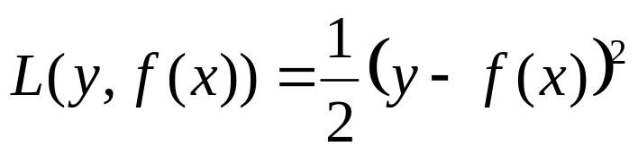
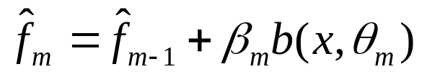

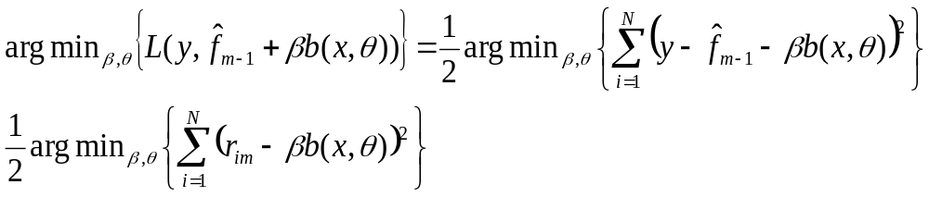

Forward Stagewise Additive Modeling
For regression the most common loss function is the squared loss function
On the m^{th} step of the algorithm the prediction is
where the coefficient and parameter
are chosen to minimize
with
the value of the residual for the previous guessed iteration.

Slide 5
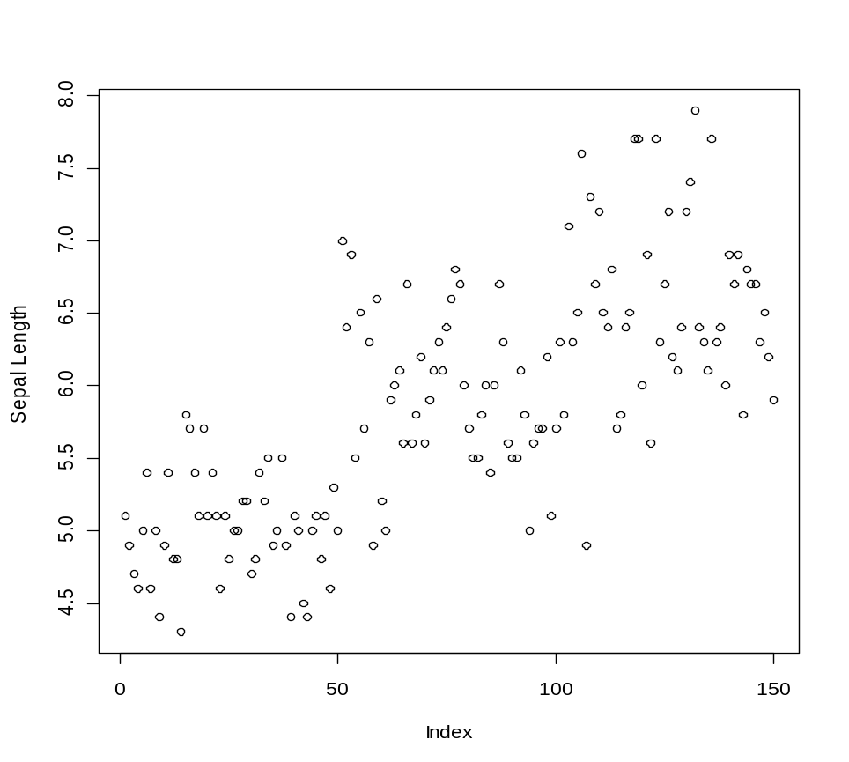
Example of Forward Stagewise Additive Modeling
Example: Suppose we restrict ourselves to the first 3 Fourier basis functions
Dataset:

Slide 6
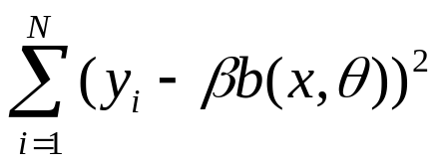
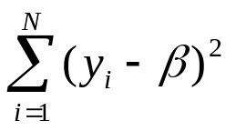


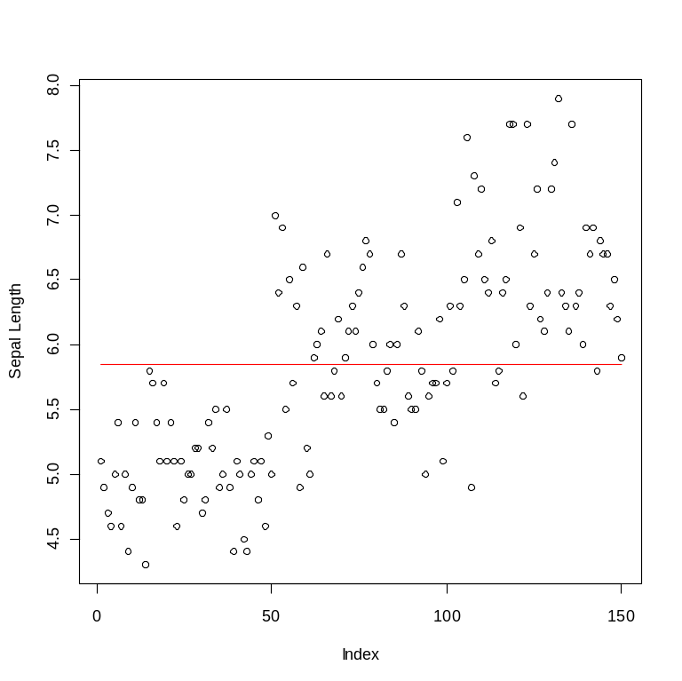
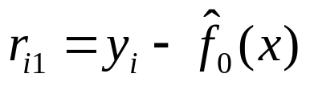
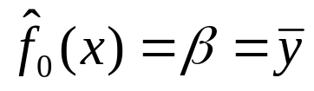
Example of Forward Stagewise Additive Modeling
Step 0: Find the Basis function and regression coefficient to minimize
Solution: Choose
and value of
to minimize
The first approximation is:
The i^{th} residual
for (m=1) =

Slide 7
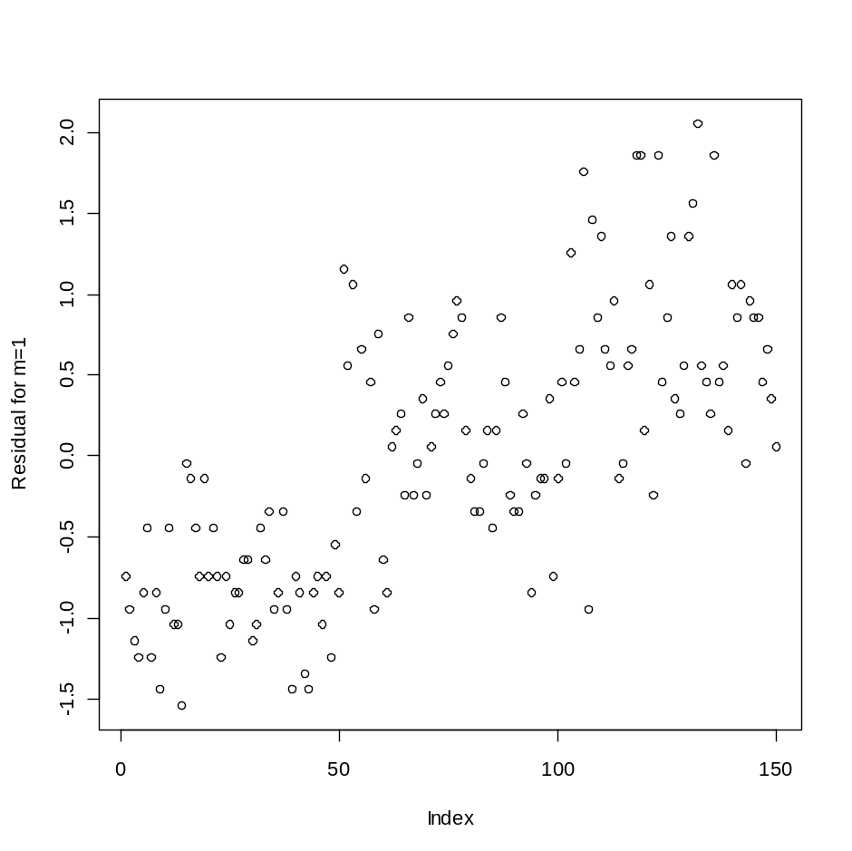

Example of Forward Stagewise Additive Modeling
Here is a plot of residuals
Data points over the fit have positive residuals.
Data points under the fit have negative residuals.
In Step 1, I replace “y”
from before with the “residuals” from the previous fit.
Step 1: Find the Basis function and regression coefficient to minimize

Slide 8

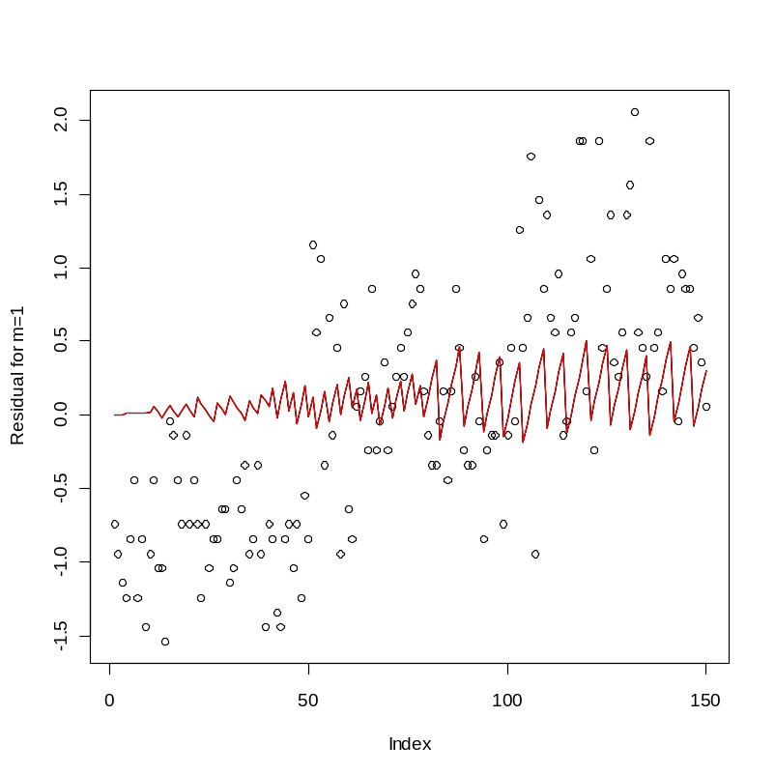

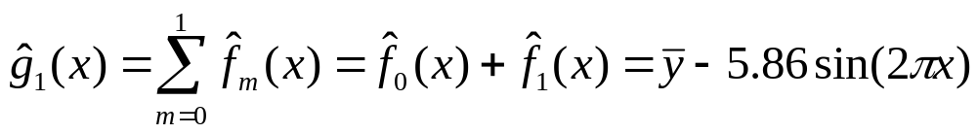
Example of Forward Stagewise Additive Modeling
Step 1 (cont) : The best basis function (of the choices I’ve offered) which minimizes
is
and the corresponding regression coefficient is
The function we
add to improve the approximation is:
Plot of residuals
r_{i1} vs x:
So after the first iteration
The (m=1) approximation is:

Slide 9


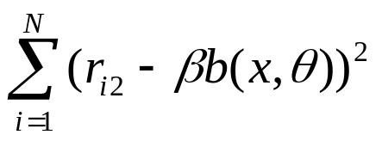
Example of Forward Stagewise Additive Modeling
Now we compute the residuals for (m=2)
The i^{th} residual
for (m=2) =
In Step 2, I also replace “y”
with the “residuals” from the previous fit.
m=2
Step 2: Find the Basis function and regression coefficient to minimize

Slide 10
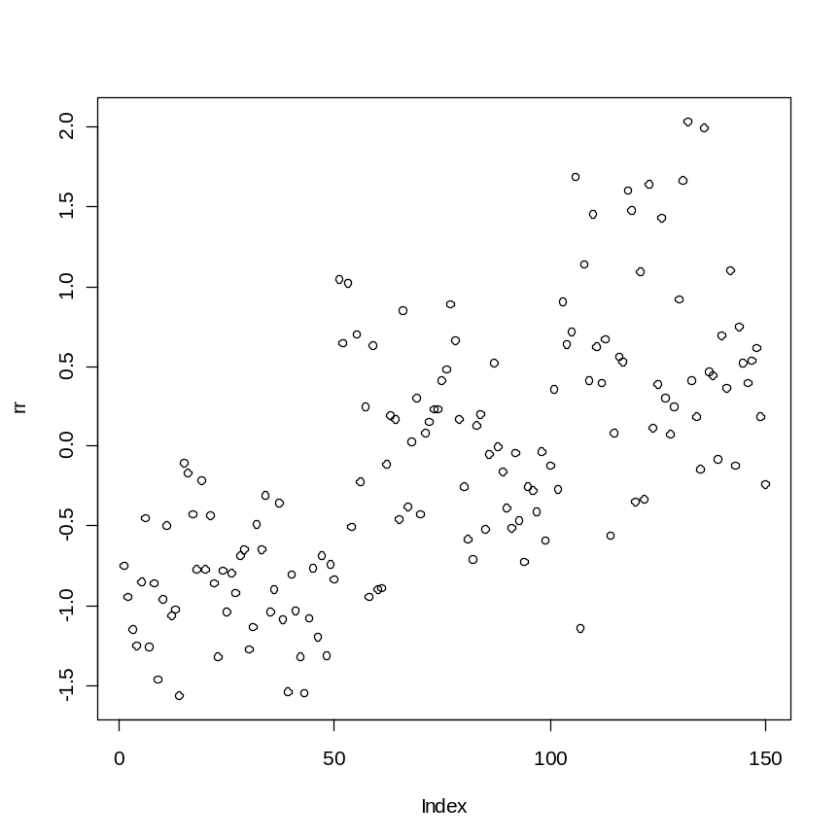


Example of Forward Stagewise Additive Modeling
Here is a plot of residuals
The function
We add to
Improve approximation now is
These residuals
Are a “little” closer
to zero on average
(would have been better if I had chosen basis better).
For m=2 the approximation is
If I had to do this over again I’d probably choose the basis
Now like the “energizer bunny” – we just keep going
and going and going……… (m=3) … (m=4) …. etc

Slide 11




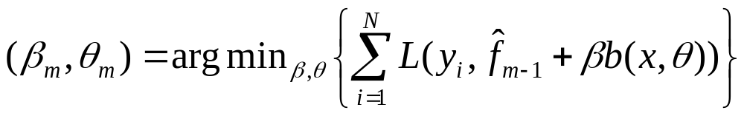

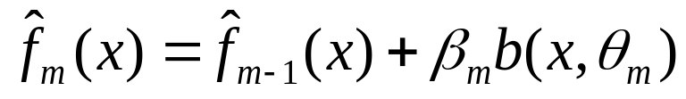
Summary of Forward Stagewise Additive Modeling
Forward Stagewise Additive Modeling Algorithm
Step 0: Find constant which minimizes the loss
and initialize (for quadratic loss ).
For m= 1 to M
(a) Compute
for some set of basis functions (parameterized by ).
(b) Set
Procedure is generalized to any loss function L(y,f(x))
not just quadratic loss, e.g. Deviance for categorical y
We can use any set of “basis” functions for example
(Fourier basis, Polynomials, Trees, Neural Networks, etc).

Slide 12
Gradient Boosting
Gradient Boosting
For Regression Trees

Slide 13
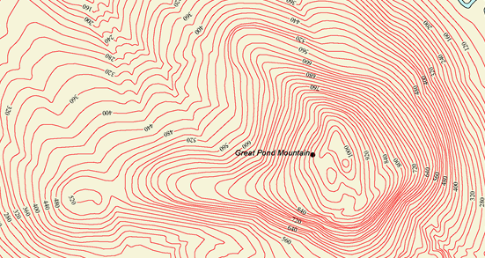

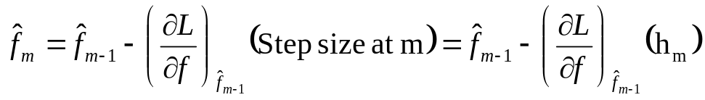
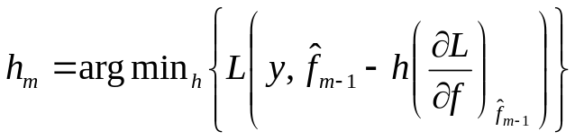
What is Gradient Boosting?
The main Idea behind gradient boosting comes from the Newton-Raphson Algorithm
The quickest
way to ascend a
mountain is to
go in direction of
steepest ascent.
Step 2 (h₂)
Step 3 (h₃)
The gradient of
A function points
in direction of maximum increase, perpendicular to contour lines
Step 1 (h₁)
Newton-Raphson Algorithm:
To find minimum (maximum) of Loss(f)
1) Guess
2) For (m=1 to M)
Choose “optimal step size” h_{m} by minimizing

Slide 14
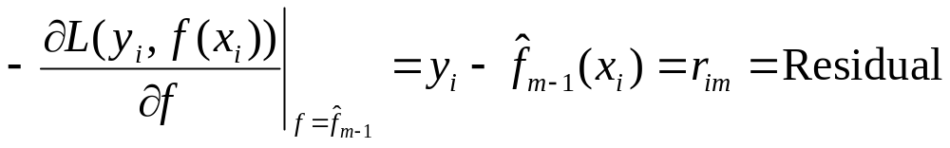
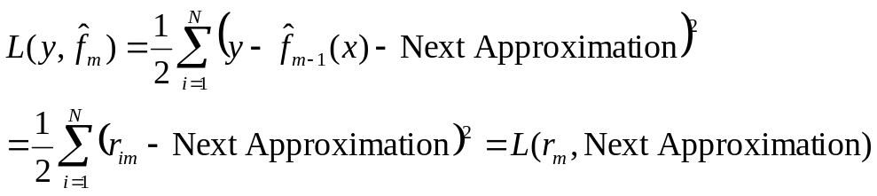
What is Gradient Boosting?
If we have the quadratic loss function
The negative gradient is
So the Newton-Raphson algorithm is:
If we let “y” be the residuals
for the model
most algorithms
will minimize quadratic loss
The residual is
The gradient
The step size h_{m} is chosen to minimize
If the “next approximation” is a regression tree then the tree will
be grown to minimize L(r_{m},TREE_{m})

Slide 15
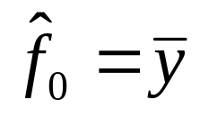

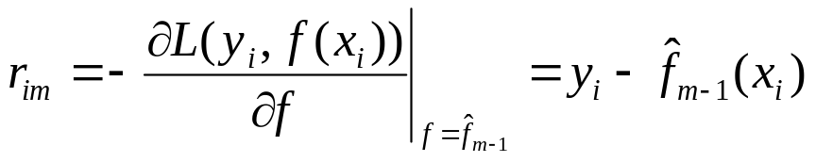
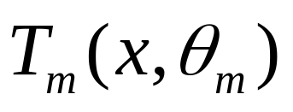
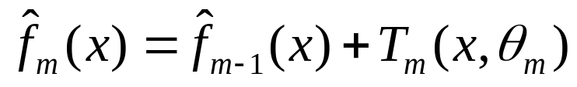
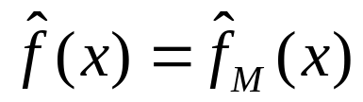
The Gradient Boosting Algorithm for Trees
Now suppose Y is continuous and we want to do Gradient Boosting on Regression Trees
Gradient Boosting Algorithm for Regression Trees
1) Initialize
(because this minimizes squared loss)
The parameters
Of a tree can be thought of as the
variables and places where we have splits.
For m = 1 to M:
For i = 1, … , N compute the residuals:
Fit a regression tree to the targets r_{im}, producing a new tree
Update
2) Output

Slide 16
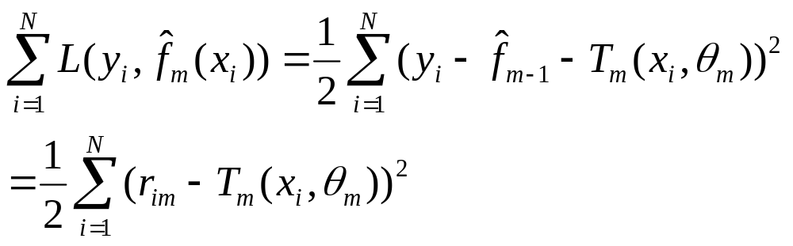
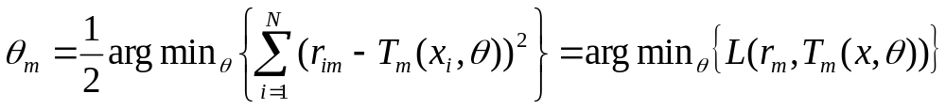
The Gradient Boosting Algorithm for Trees
Notice that at every iteration m we are minimizing
since the split points on the m^{th} tree are chosen in such a way so that it minimizes
the squared loss, in other words
At every iteration the splits are chosen to minimize this
Now lets see how this works with a picture filled example……

Slide 17
A Pictoral Example (The Dataset)
Dataset: Take the Iris datset
Y = Sepal Length
X variables:
Sepal Width (continuous)
Petal Width (continuous)
Petal Length (continuous)
Species (categorical)
Virginica
Setosa
Versicolor

Slide 18
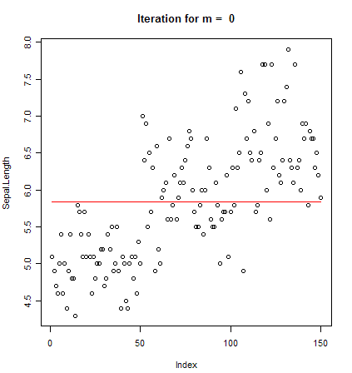
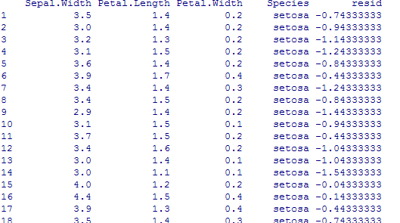
A Pictoral Example (m=0)
m=0:
Now compute the residuals and use this as “the target” for the next iteration.
The column resid is the target
When we grow Tree₁(x)
The other columns are the X variables when we grow Tree₁(x)

Slide 19
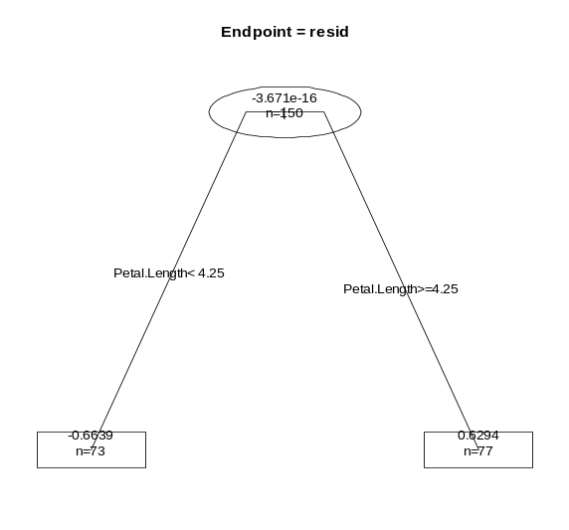

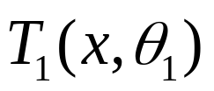


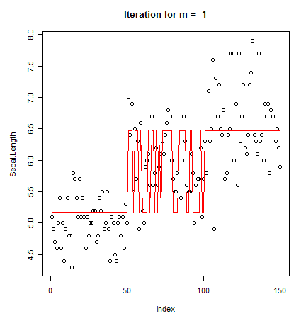
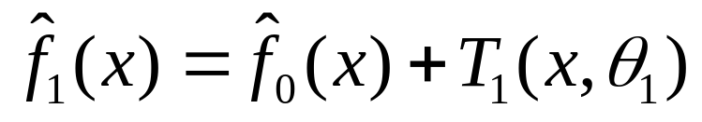
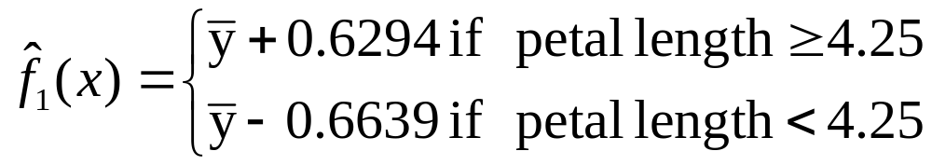
A Pictoral Example (m=1)
m=1:
Grow a tree using “resid” as the target
R code: fit = rpart(resid~., data = newdata,
control=rpart.control(maxdepth=1) )
Command grows a tree “stump”
Here is
Plot of

Slide 20

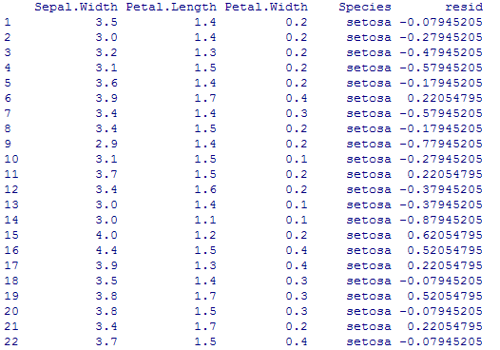
A Pictoral Example (m=1 continued)
still m=1
Now compute the residuals and use this as “the target” for the next iteration.
Replace the residuals
in the previous
Dataset with new residuals
The new column “resid” is now target
When we grow Tree₂(x)

Slide 21

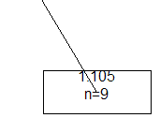


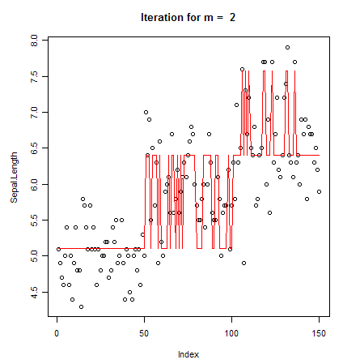
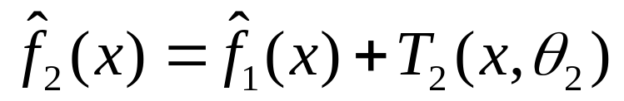
A Pictoral Example (m=2)
m=2:
Grow a tree using “resid” as the target
R code: fit = rpart(resid~., data = newdata,
control=rpart.control(maxdepth=1) )
We will continue to grow a tree “stumps”
Here is
Plot of
Now continue this process…

Slide 22
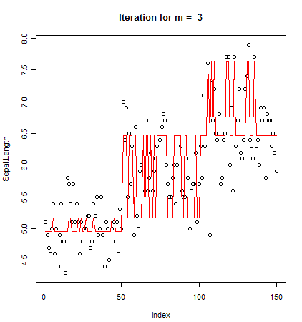
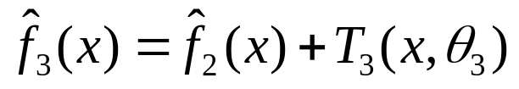
A Pictoral Example (m=3)

Slide 23
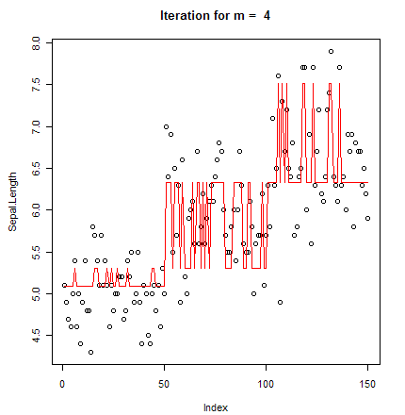
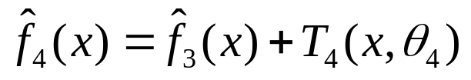
A Pictoral Example (m=4)

Slide 24
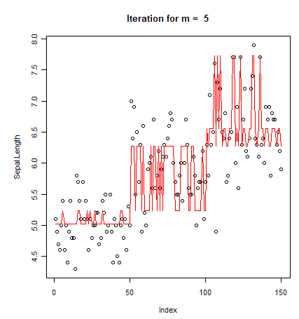
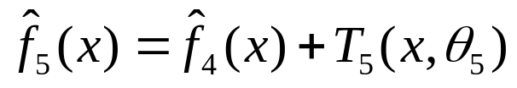
A Pictoral Example (m=5)

Slide 25
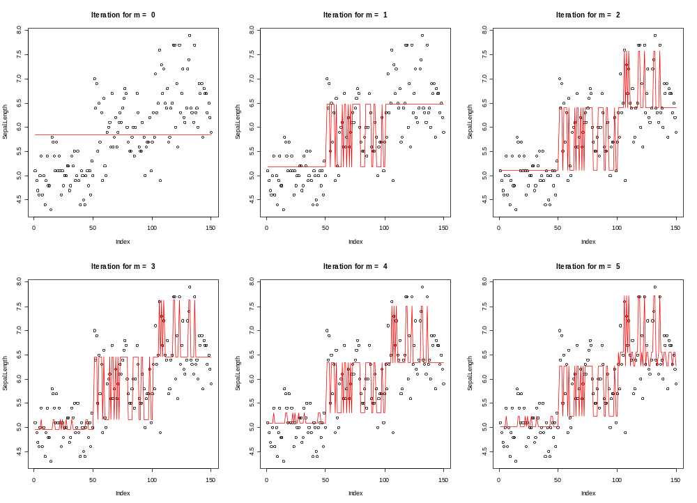
A Pictorial Summary of steps (m=1 thru 5)
R²=0
R²=0.38
R²=0.689
R²=0.785
R²=0.738
R²=0.792
Note that at every step we only add a “Tree stump”

Slide 26
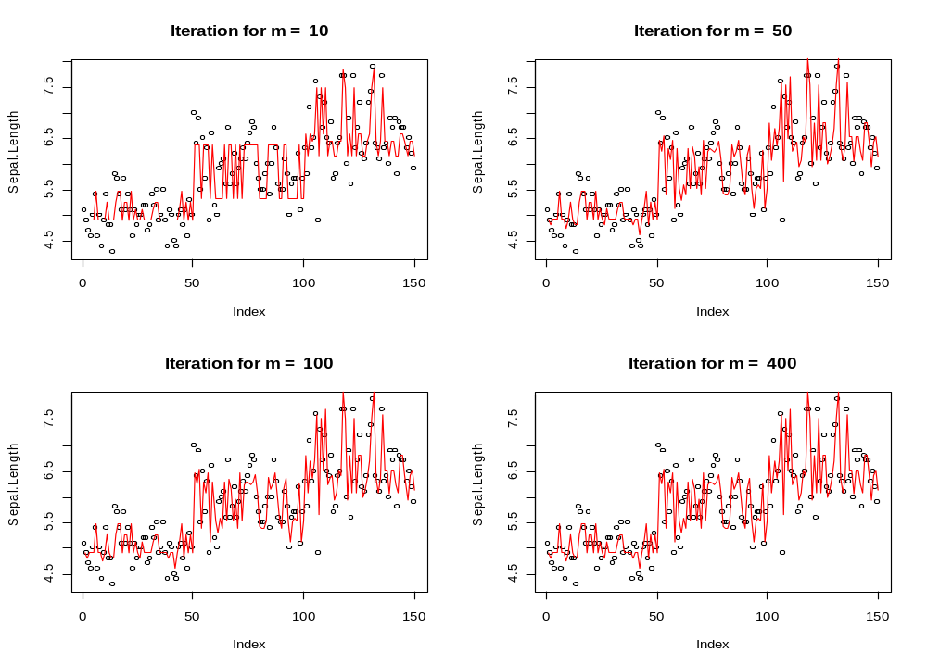
A Pictorial Summary for steps (m=10,50,100,400,…)
Small difference
R²=0.832
R²=0.879
No difference
No difference
R²=0.879
R²=0.879
Notice that the algorithm seems to converge between 10<m<50
Algorithm converges just like Newton-Raphson!!

Slide 27

New simulation
In the previous experiment we constructed a boosted tree
model consisting of “tree stumps” by restricting the tree depth = 1.
What would happen if we removed the restriction and allowed trees of any depth?

Slide 28


Tree grown for m=1

Slide 29

A Pictorial Summary for steps (m=0,1,2,3,4,5,…)
R²=0
R²=0.463
R²=0.870
R²=0.909
R²=0.921
R²=0.928

Slide 30

Boosted Trees grown without restricting depth
R²=0.941
R²=0.941
R²=0.941
R²=0.941
Final Model seems to OVERFIT the data. What do we use to quantify overfit?

Slide 31

How do you tell if a model is overfit?
One important goal of any statistical model is to PREDICT NEW OBSERVATIONS
The R² tells the user how good the model predicts observations which the model trained on
But in modern times – ALL STATISTICAL MODELS WILL HAVE GOOD FITS TO THE TRAINING SETS. No one really cares anymore what the R² value of a model is, they assume its large.
What people want to know is: How well does the model do at predicting New observations
Training Data
Test Data
Training Data
Training Data
Training Data
Training Data
Cross validation (CV) measures model PREDICTIVENESS because the model is trained
the set of training data, while the error is measured on the Test data.
Because the test data is not used to train the model it simulates new observations.

Slide 32

Comparison of Boosted Models
Boosted tree
With (no limit on tree depth)
Boosted tree
Where we limit tree depth to 1
(Boosted tree Stumps)
The boosted tree stump model is better at prediction
than the boosted tree with no limit on depth
It is perhaps worthwhile to mention that the boosted stump model (R² = 0.879)
IS BETTER than boosting trees with no limit on depth (R² = 0.941)

Slide 33

Comparison of Boosted Trees with Single Tree
Now lets compare Boosted Trees with a single tree:
CV Error = 0.23
R²= 0.862
The picture on the right is the regression tree
Grown without boosting.
Model | CV Error
A Single Tree | 0.23
Boosting Tree Stumps | 0.19
Boosting Full Trees | 0.264
Boosting tree stumps is better than a single tree.
Boosting can improve the CV error of a single tree, however boosting complex
trees can actually hurt the model performance.
Its worth mentioning that a single tree (R² = 0.862) is a better predictor
than boosting full trees (R² = 0.941) as well.

Slide 34

But now the question is What should Tree Depth be for boosting trees?
Depth of Tree | CV Error
1 Level (tree stump) | 0.189
2 levels | 0.179
3 levels | 0.225
4 Levels | 0.246
No Restriction on Levels | 0.264
Answer: Plot CV vs level of depth
Model Complexity
The best model = boosted tree grown with 2 levels
No limit
on tree depth

Slide 35




But what is so great about boosting?
Thought experiment: Suppose m=2
Since the second tree
is fit to the residuals of the first tree
Each successive tree is fit to data where the previous models fit poorly.
adjusts for some of the errors that had
If is large, then tends to be small and vice versa
Thus
This is why boosting can increase performance

Slide 36
Now what do you do if Y = Category?
Gradient Boosting for Categorical Trees

Slide 37



Now what do you do if Y = Category?
If Y is a category the quadratic loss function
will no longer work because no one knows what
So here is how we measure the Loss function for a Categorical Y
Assume that Y has a value in one of K categories { 1, 2, … , K }
First create K
Indicator columns
{Y₁,….,Y_{K}}
Y = Species
same applies for
{ Y₂, … , Y_{K} }

Slide 38





What is Loss Function if Y = Category?
Now, based upon the explanatory variables {x}, each row will have a prediction
Which is a predicted probability of being in class k
Predicted probability of being in class 1, given x
Predicted probability of being in class 2, given x
Predicted probability of being in class K, given x
For each row {x_{i},y_{i}} of the dataset:
we measure the loss between the prediction and the actual
By using the formula for the Deviance or Cross Entropy:
and the Total Deviance is computed by:

Slide 39






The Multinomial Logit Function
Now it is necessary to ensure that our prediction satisfies the constraint:
So in order to satisfy this constraint we let
be K predictions from a regression tree
with the relationship between the
and the
given by
f(x) is the Multinomial Logit
Function of p(x)

Slide 40





Procedure for Gradient Boosted Classification Trees
1) (m = 0) Initialize
so that
2) For m = 1 to M:
Think of
R_{jkm} as the
Rectangles
Formed by
The regression tree nodes
a) Compute the negative gradient
Fit a K regression trees to the targets r_{ikm} giving terminal
regions R_{jkm} for j = 1,2, …, # of Nodes
Adjustment factor to correct
For multinomial
Logit function
c) Compute
d) Update

Slide 41

Tired, I’m going home

Slide 42


Picture of First Tree Stump Grown
Training Error
Training Set Error | Correct Classified | Mis-Classified | Misclassification %
Leaf 1 | 93 | 77 | 45%
Leaf 2 | 29 | 1 | 3%
Total | 122 | 78 | 39%
Test Error = 43.3%

Slide 43

Plot of the First Tree on the (X6,Y) axis
Red = Prediction
From first tree stump grown
Black = Actual Y

Slide 44
Bibliography
Y. Freund and R.E. Schapire. (1997). “A decision-theoretic generalization of on-line learning and an application to boosting.” Journal of Computer and System Sciences, Vol. 55(1) pp. 119-139.
J.H. Freidman. (2002). “Stochastic Gradient Boosting.” Computational Statistics and Data Analysis. Vol. 38(4). Pp.367-378.
Hastie,T., Tibshirani, R., and J.H. Friedman (2009) , The Elements Of Statistical Learning”, Springer, New York, Second Edition.
R Software (2009). Package “gbm”
Ridgeway, G., (1999). “The state of boosting.” Computing Science and Statistics. Vol. 31 pp. 172-181

